Slide 1
Global kirurgi – et norsk problem?
Brynjulf Ystgaard
St Olav Hospital & CapaCare

Slide 2
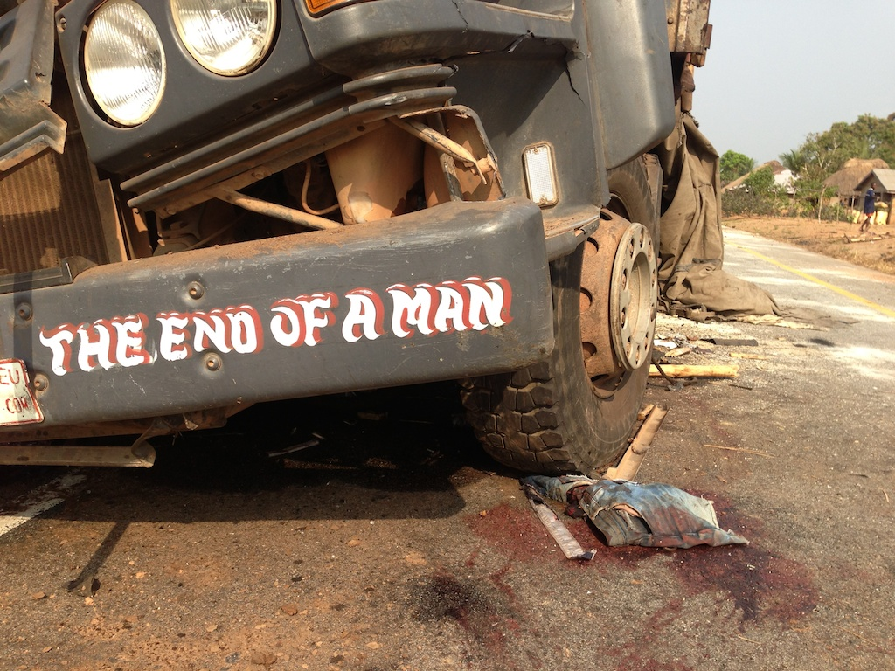

Slide 3
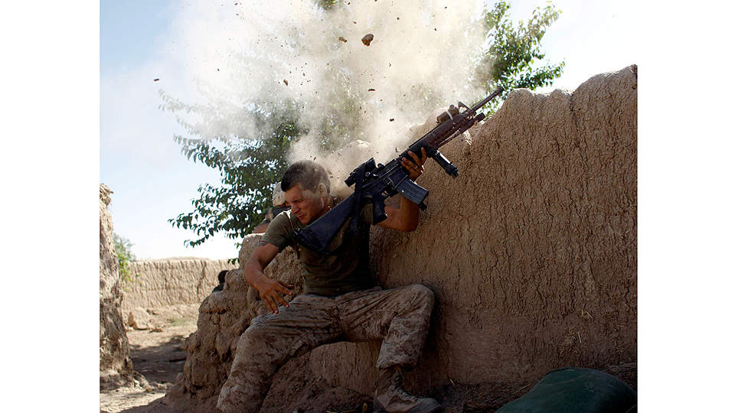
Kirurgi I Krig og katastrofe
Nær slektning, men ikke synonyme begreper

Slide 4
Measurement of Health Status I
Cause of death
Obtained from death certification but limited because of incomplete coverage
Life expectancy at birth
The average number of years a new-borns baby could expect to live if current trends in mortality were to continue for the rest of the new-born's life
Maternal mortality rate
The number of women who die as a result of childbirth and pregnancy related complications per 100,000 live births in a given year
Child mortality rate
The probability that a new-born will die before reaching the age of five years, expressed as a number per 1,000 live births

Slide 5
Example
100,000 children
Sick for 1 week with a disease with a disability weighting* of 0.3
2% die at 1 year old.
DALYs = YLL + YLD
= (2000 X 80) + (100,000 X 7/365 X 0.3)
= 160,000 + 575
= 160,600
Notes:
5

Slide 6
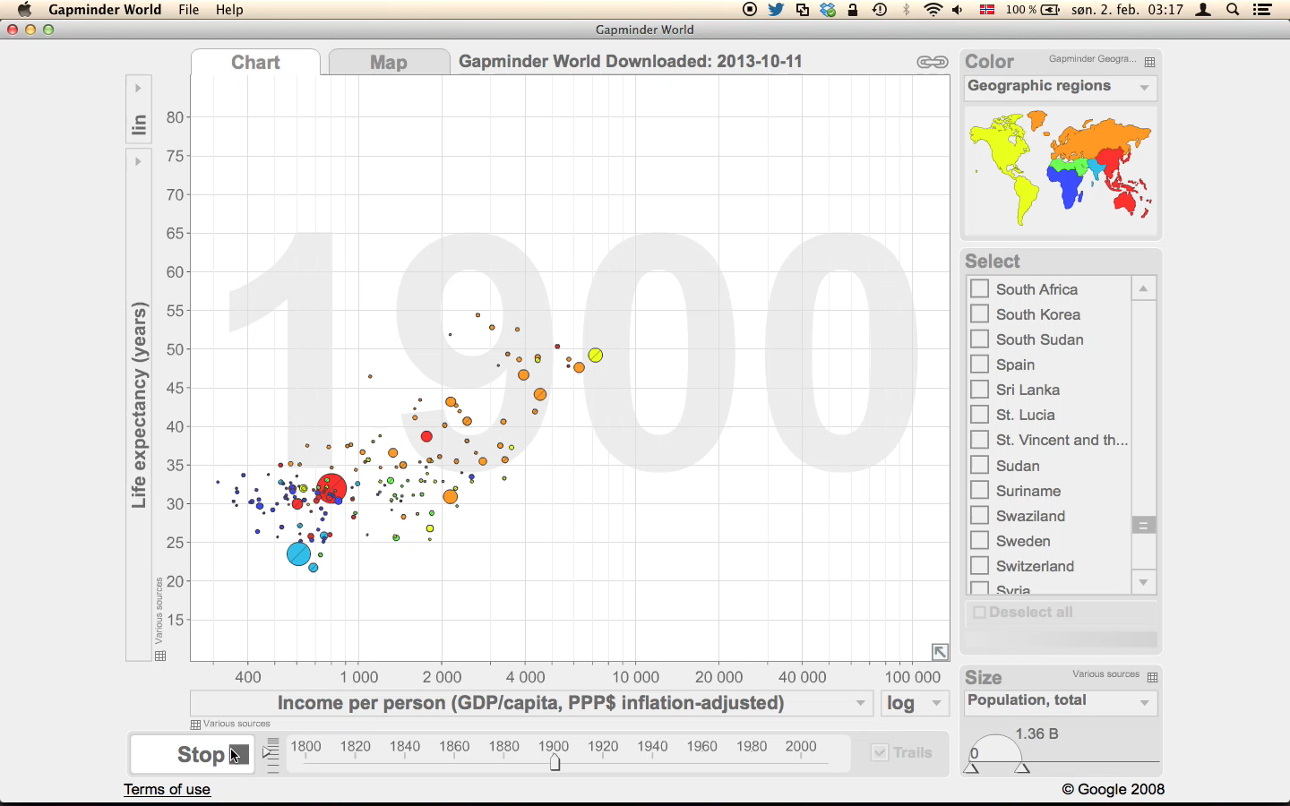

Slide 7
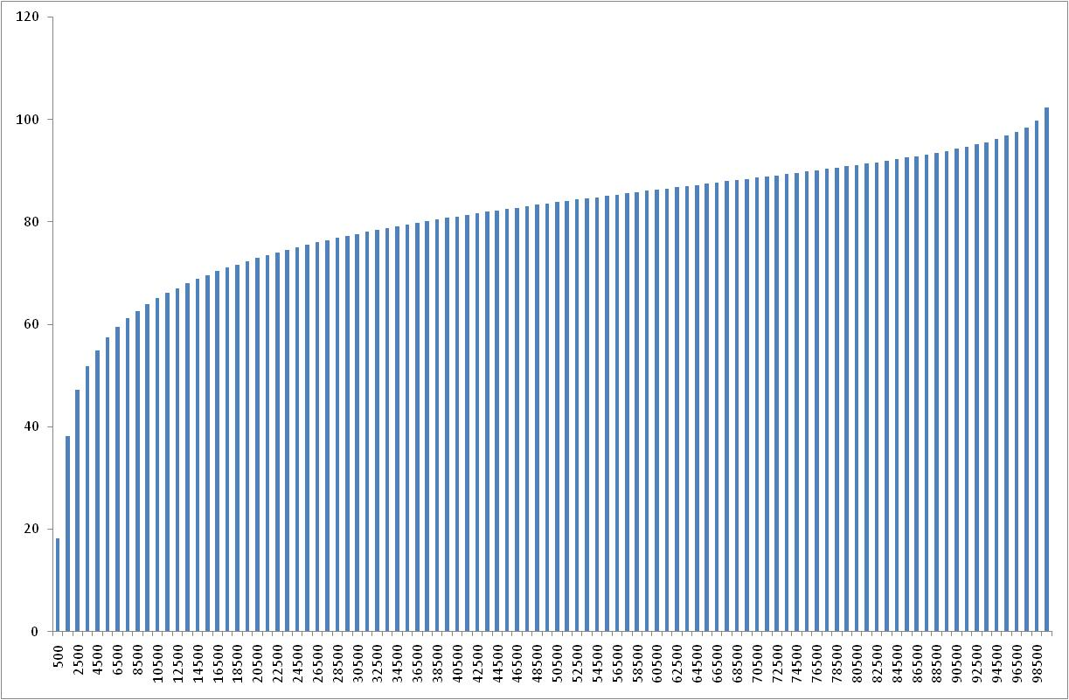
100
Sweden
2007
Life expectancy (years)
81 years
80
60
40
20
0
200 $
2000 $
20 000 $
1

Slide 8
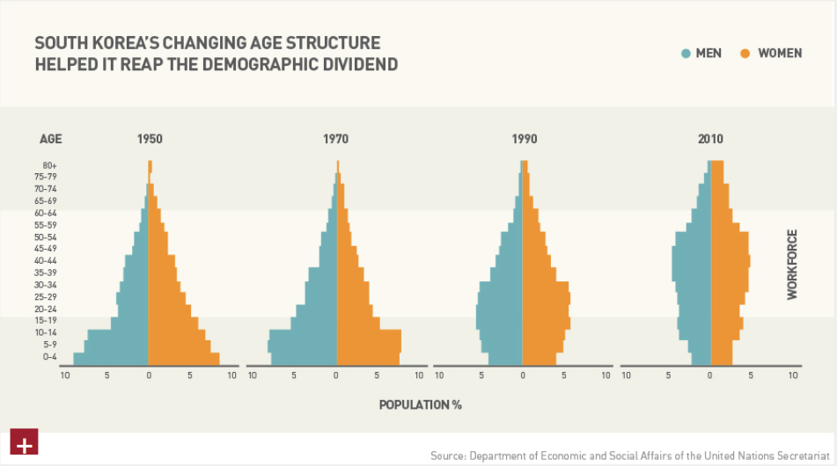
Demographic transition

Slide 9
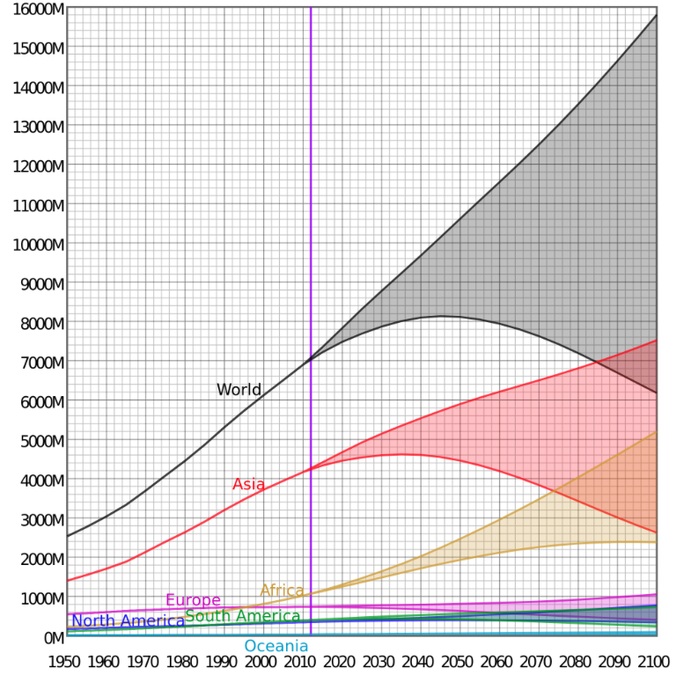
Source: United Nations Department of Economic and Social Affairs - 2010

Slide 10
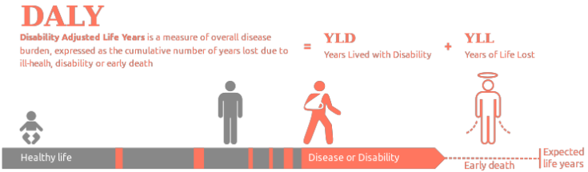
What is DALY?

Slide 11
DALY
NTD – Big 3: HIV / Tbc / Malaria
20 mill DALYs
Injuries: RTA
1.7 vs 50 casualities/10 000 vehicles
10 million DALYs
Obstretics complications
4 million DALYs

Slide 12
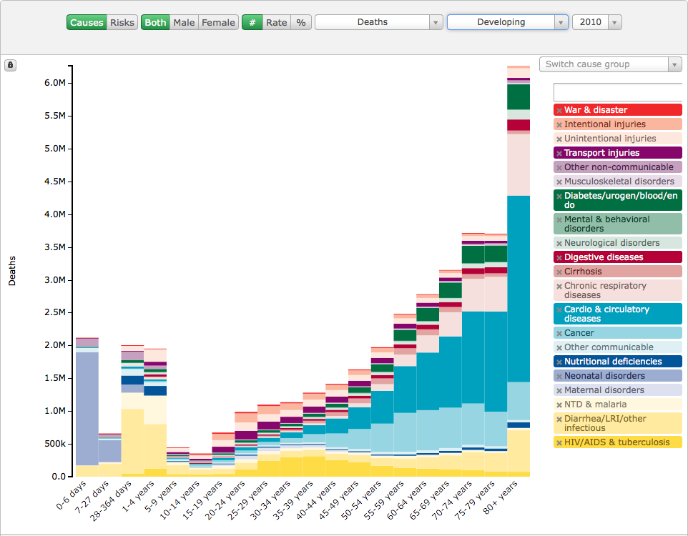
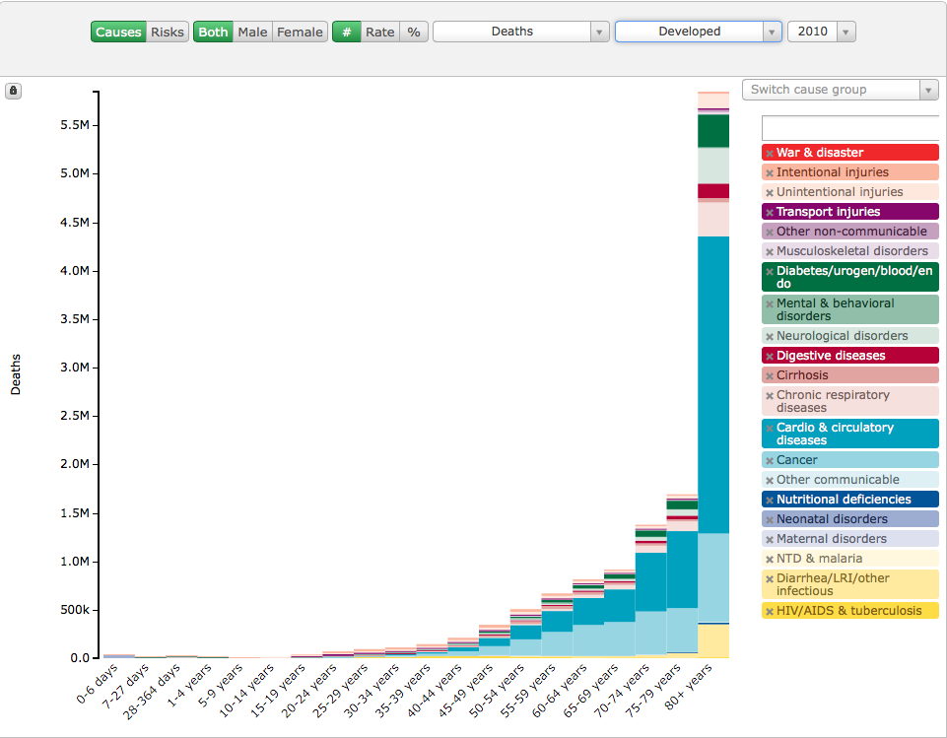

Slide 13
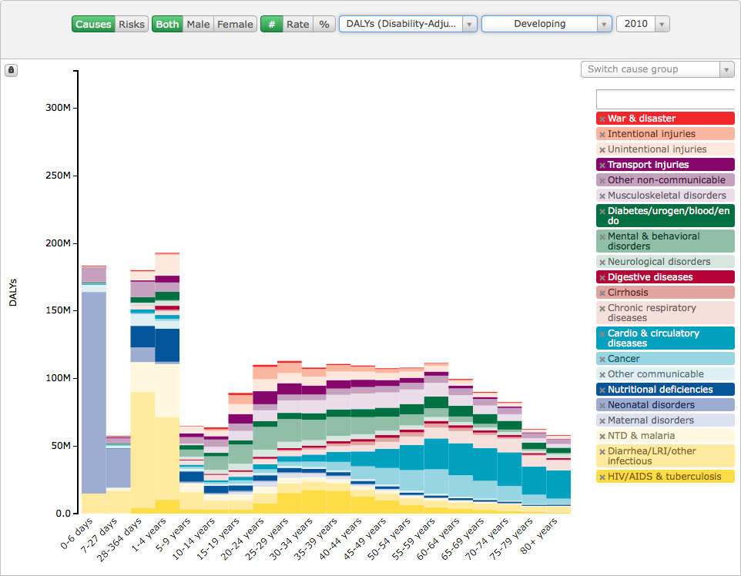
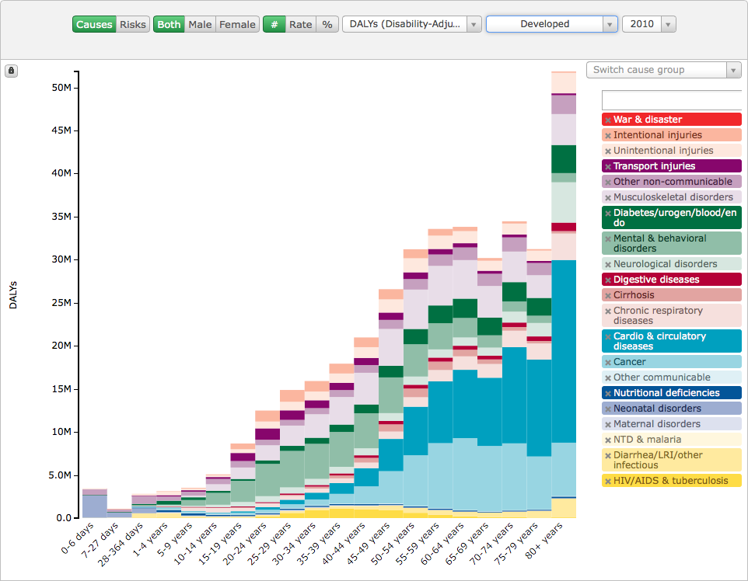

Slide 14
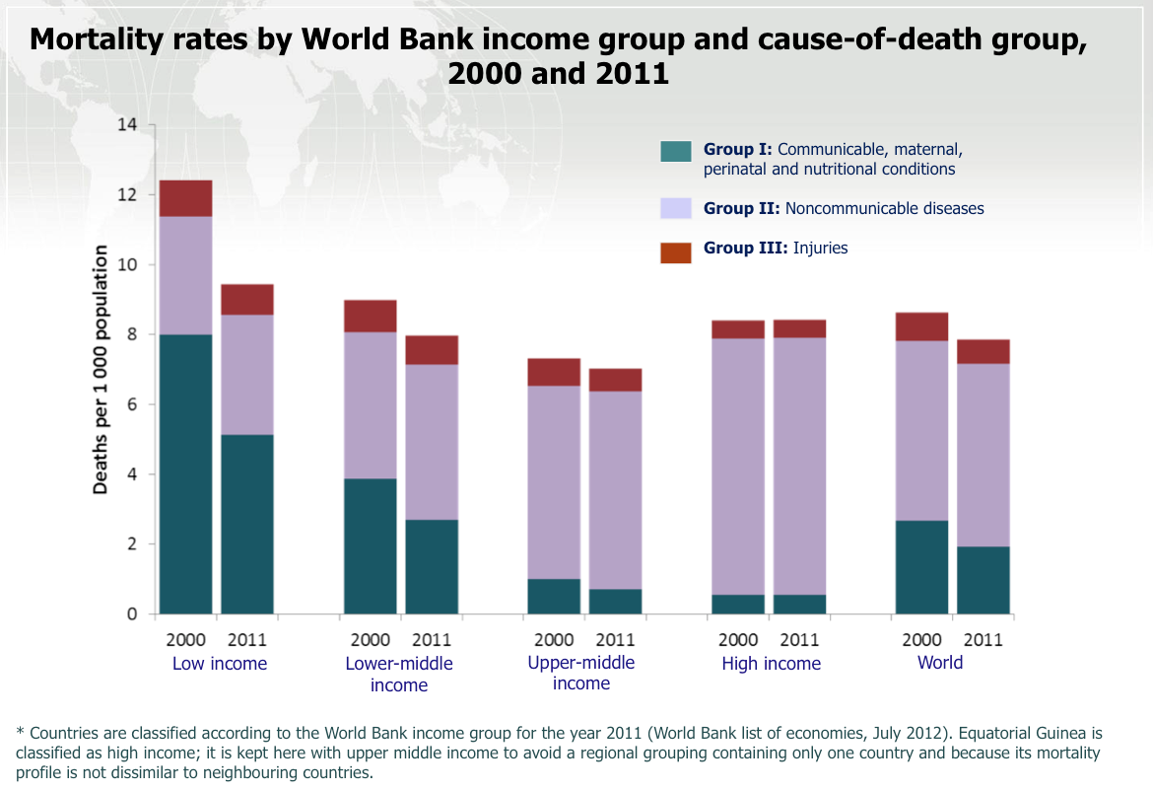

Slide 15
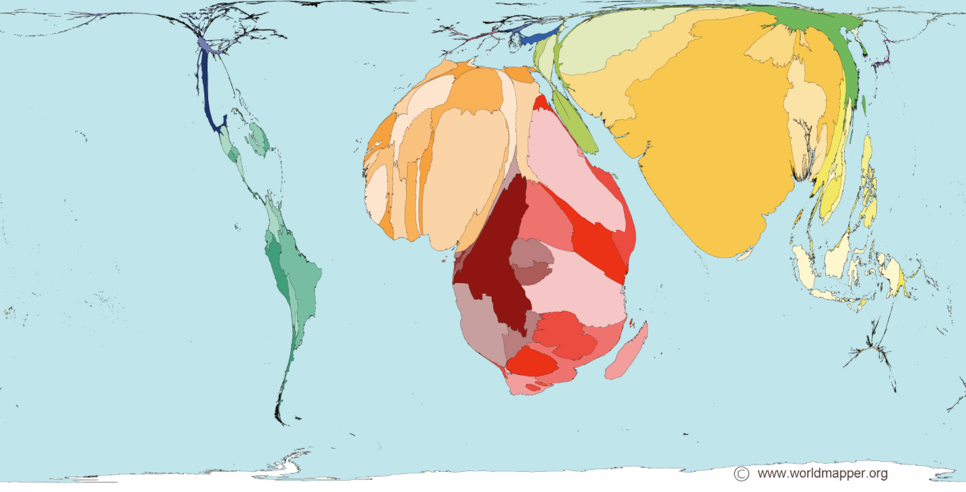
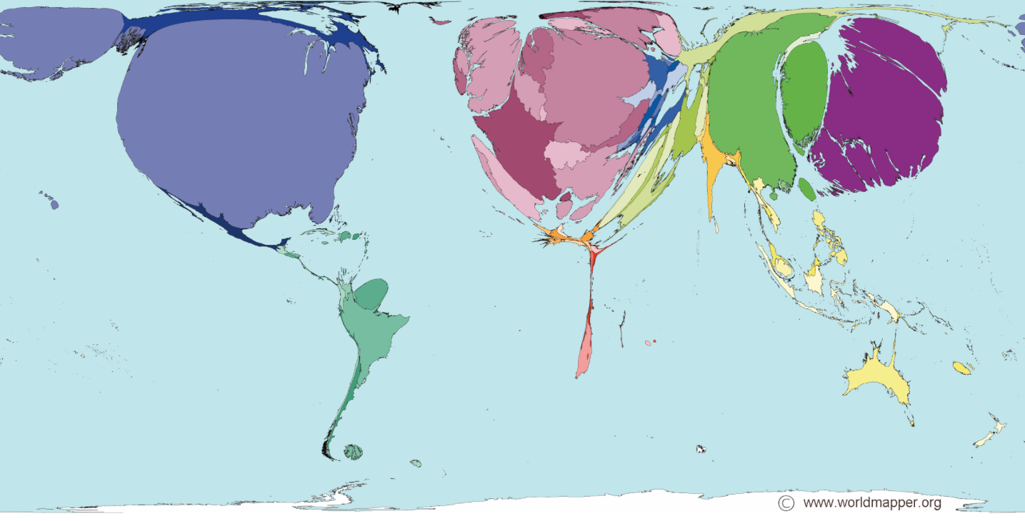
U - 5 Mortality:
Available Medical doctors:
Source:
Worldmapper.org
(World Bank – data)

Slide 16
Global health workforce distribution
Source: Håkon A. Bolkan

Slide 17
Global mal-distribution of Surgical services
1 per 340
1 per 9 years
of living
Weiser 2008 - An estimation of the global volume of surgery a modelling strategy based on available data;
The Lancet; June 25, 2008 DOI:10.1016/S0140-6736(08)60878-8

Slide 18
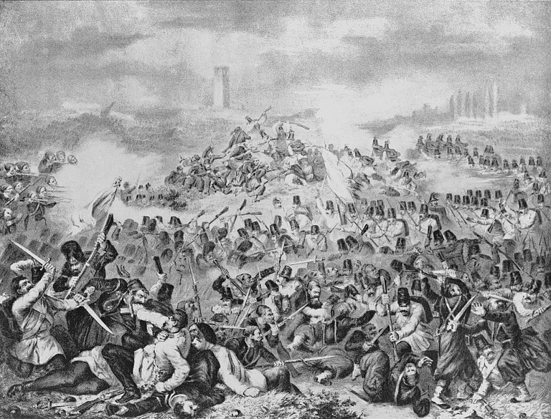
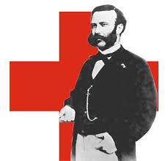
Henri Dunants arv
Notes:
Presentasjon av Røde kors

Slide 19
Krigskirurgi a m Røde Kors
Følger generelle organisatoriske prinsipper
Samordning av behandingspolicy
Gjenkjennbare prosedyrer verden over

Slide 20
Generelle prinsipper
Redde liv før funksjon
Konvertere infiserte sår til rene
Debridement
”Enkel” antibiotikapolicy

Slide 21
Tilheling
Forsinket primær lukning
Fire dager etter primærkirurgi
Direkte lukning eller hudtransplantasjon
Evt re-debridement

Slide 22
Mineskader
Anti-personellminer
Konstruert for å lemleste
”Fattige lands atombomber”
En mine pr innbygger i Afghanistan i 1992

Slide 23
Ofte lite diagnostiske problemer
Notes:
Teknologisk support/ røntgen

Slide 24
Frakturer
Konservativ tilnærming
”Life before limb”
Ingen interne fiksasjonsmidler
Strekkbehandling
Gips
Ekstern fiksasjon

Slide 25
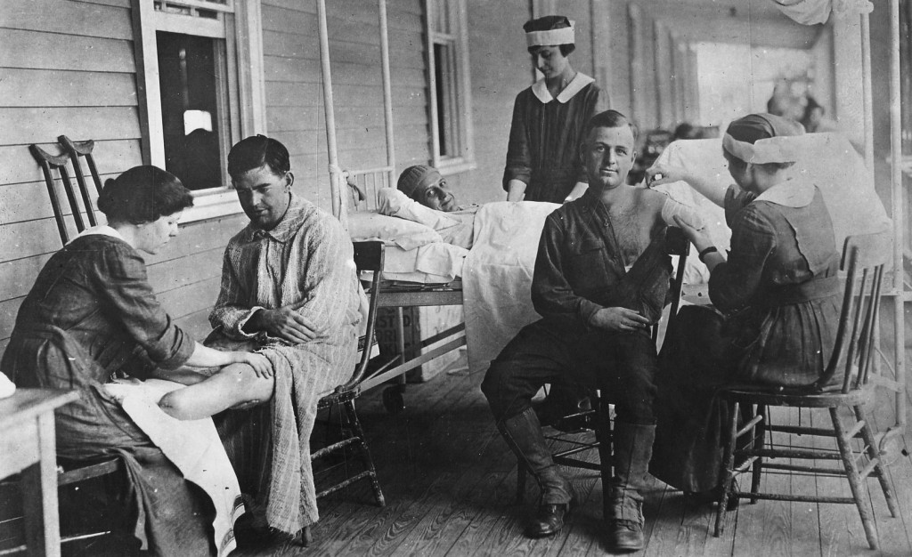
Amputasjoner - proteser

Slide 26
Senkomplikasjoner
Behandles når mulig
Kapasitet
Fasiliteter – tekniske og personellmessige

Slide 27
Kan være svært vanskelig…..

Slide 28
”Sivil” kirurgi
Når nødvendig og mulig
Varierer med lokalisasjon
Krav til kvalitet varierer sterkt
Krav til elektiv kirurgi

Slide 29
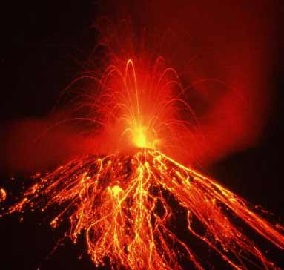
Naturkatastrofer
Point impact disasters
Jordskjelv
Vulkanutbrudd
Tsunami
Progredierende
Flom
Tornado

Slide 30
Disaster Impact Time Line
0Hr…12…24…36…48…72…Day 4…5…6…7…8…9…10…Week 4…5…6+
FACT/RDRT – Day 3+
Local Assessment NS
Deaths and Burial
Deaths
SAR & FA
Evac.
Long term Care
Serious Injuries Treated
Community Hlth
Epidemics. If Any
Number of Homeless
In temp. shelter
Chronic Illness and Other Injuries
Rapid Hospital
ERU – Day 5+
Local Services and Response
0Hr…12…24…36…48…72…Day 4…5…6…7…8…9…10…Week 4…5…6+

Slide 31
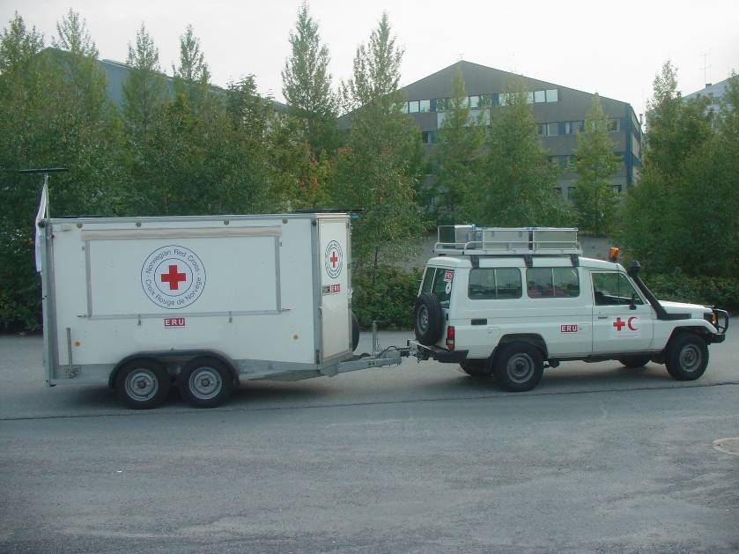
Rapid Deployment Emergency Hospital

Slide 32
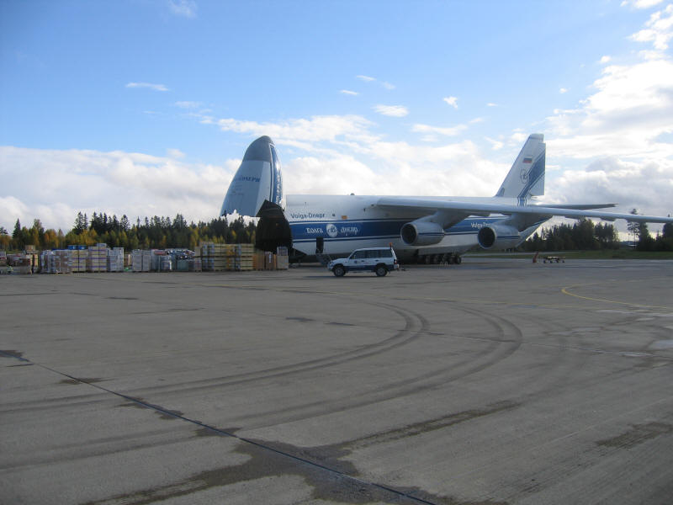

Slide 33
Rapid Deployment Hospital

Slide 34
Referral Hospital ERU

Slide 35
Operasjonstue i telt
Notes:
Dr. Arthur Halvorsen, nurse Tove Gunleiksrud and midwife Aline Gagnon at surgery just after deleivery of the first baby at the field Hospital. Treating the first patients at the field hospital at the General Hospital grounds in Port-au-Prince, in earthquake area in Haiti. (Photo: Olav A. Saltbones/Norwegian Red Cross)

Slide 36
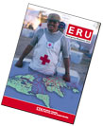
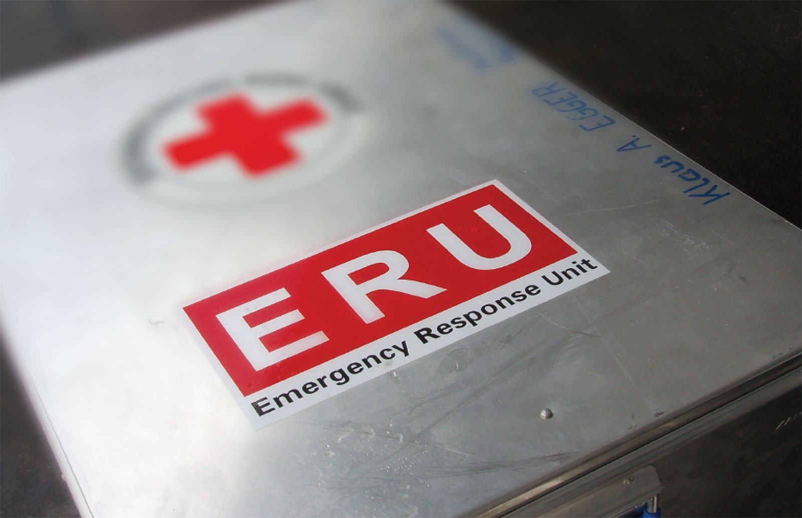

Slide 37
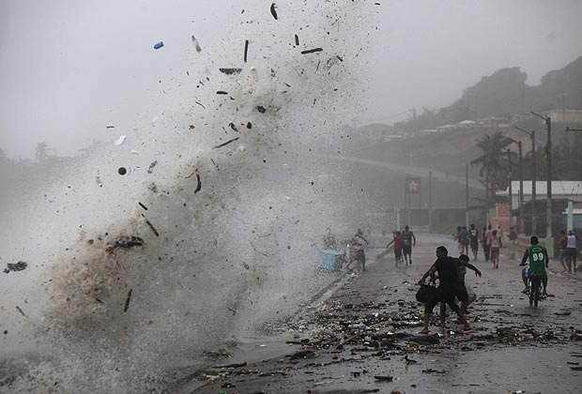
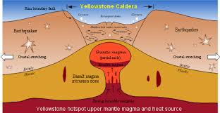
Trusselbilde
IS – war of attrition
Klimaendring
Oversvømmelse/stormer
Befolkningsvekst
Jordskjelv
Vulkanutbrudd
Notes:
Stadig bedring – men ser vi en endring nå? Resilience

Slide 38
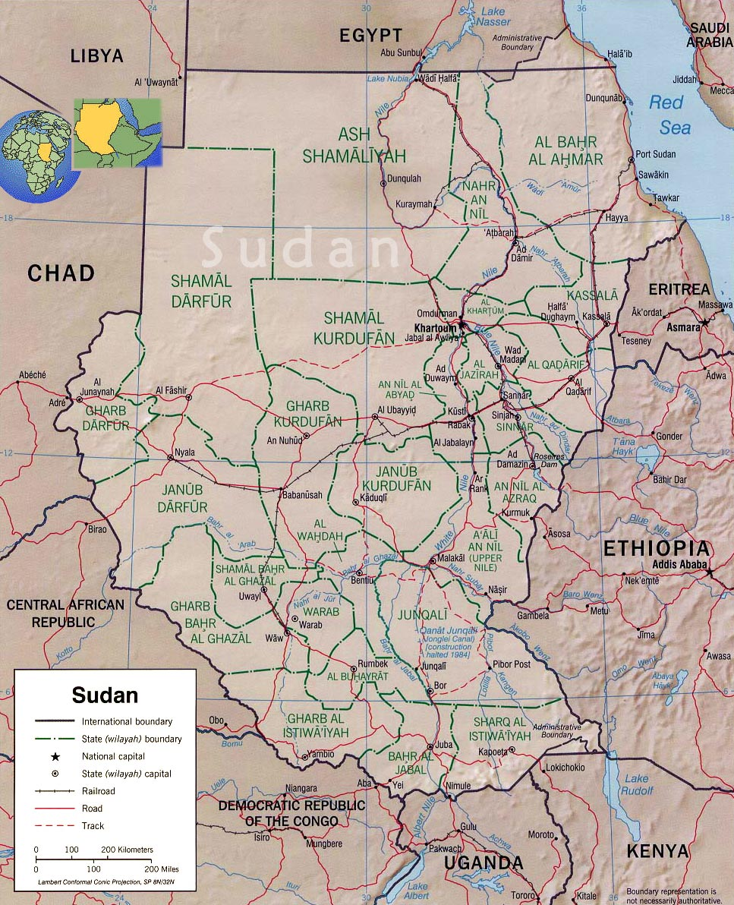
Ingen katastrofer i Sudan?

Slide 39
Sub-Saharan Africa
24 % of global burden of diseases
3 % of global health work force

Slide 40
Projected global deaths for selected causes, 2008-2030 all age groups

Slide 41
The Surgical Workforce Crisis
 | Freetown | Provinces | Total
Surgeons | 12 | 2 | 14
Obstetrician/gynaecologist | 6 | 1 | 7
MD practising surgery | 1 | 3.5 | 4.5
Surgical Technician | 10 | 4 | 14
Kingham 2009 - Quantifying Surgical Capacity in Sierra Leone; Arch Surg. 2009;144(2):122-127

Slide 42
The Surgical Training Program
Objective: To increase the surgical capacity in Sierra Leone
By training Medical Doctors and Community Health Officers
in basic life saving surgery and obstetrics
By having a strong cooperation with the Ministry of Health and Sanitation
By creating a strong network together with 8 other hospitals
By using the example of surgical task-shifting from East-Africa

Slide 43
Training Overview
 | Training (2 years) |  | Exam | Houseman Ships
Practical training | Basics Masanga | Partner hospitals (2-3) |  | Conaught and/or PCMH
Theoretical / Skills training | Visiting consultant specialists in: Surgery and orthopedics Obstetrics and gynaecology Radiology (Ultrasound) Anesthisiology

Slide 44
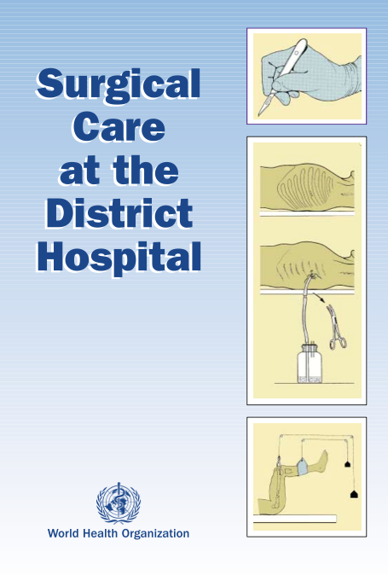
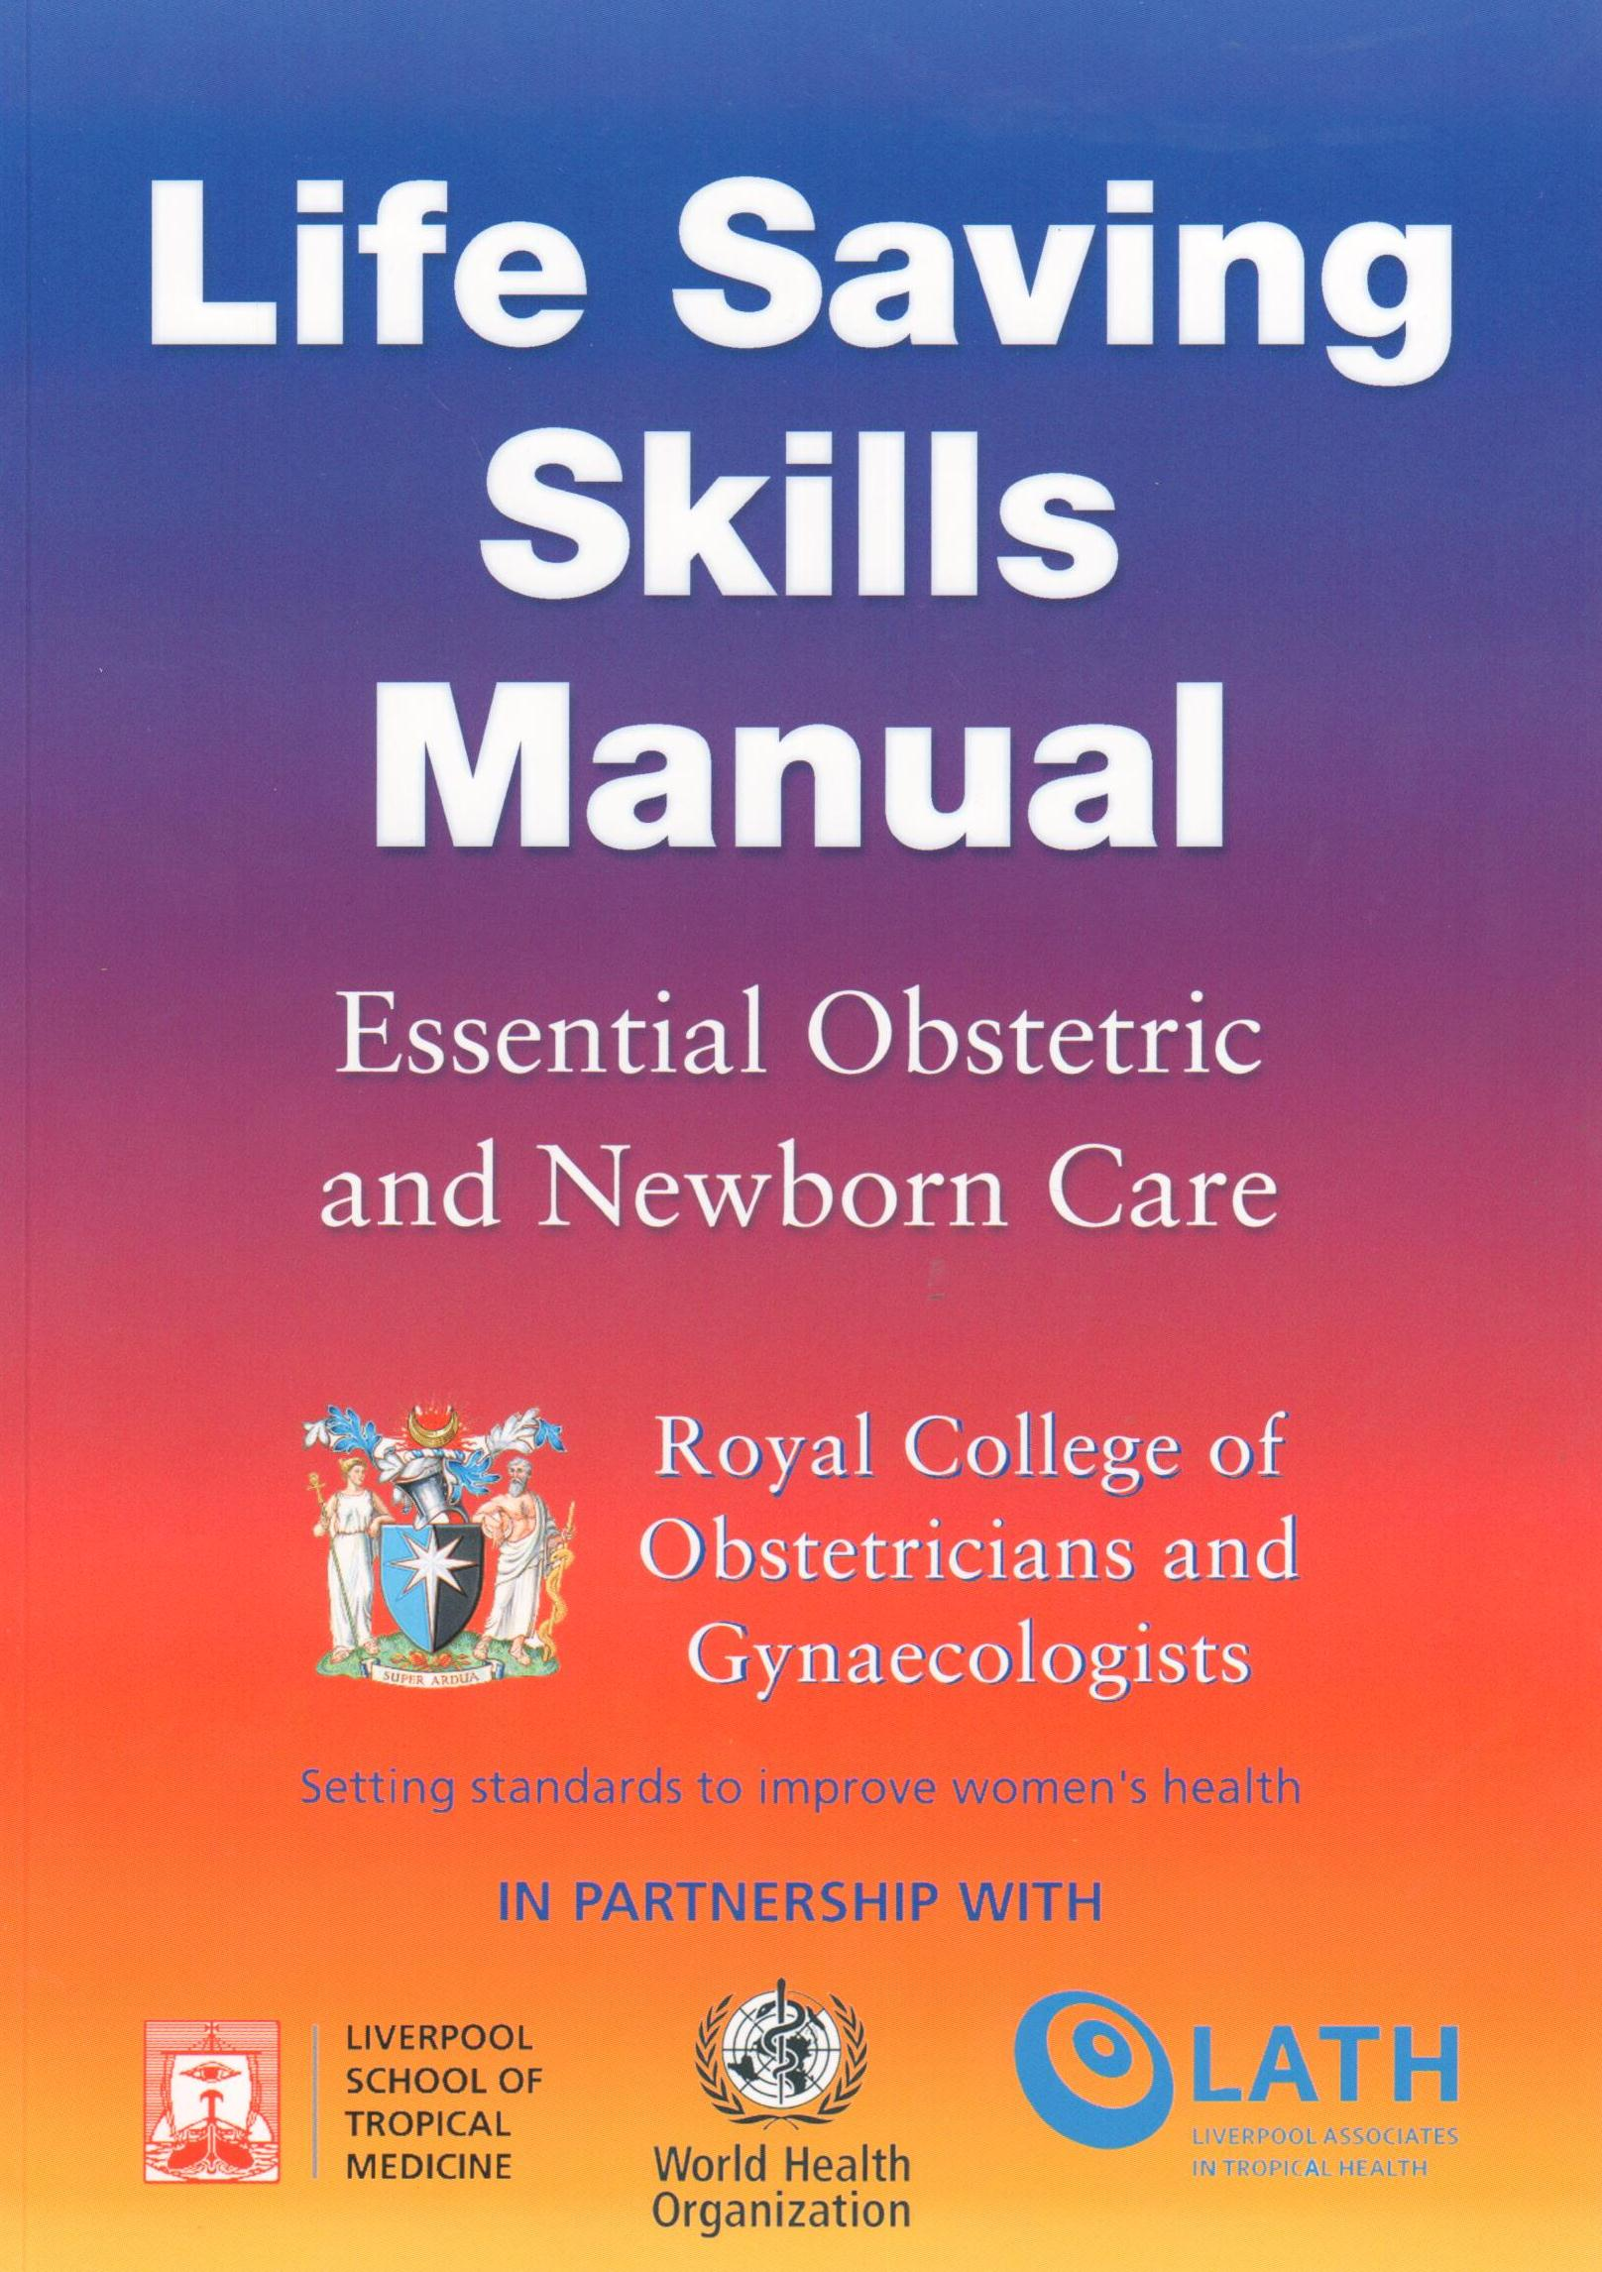
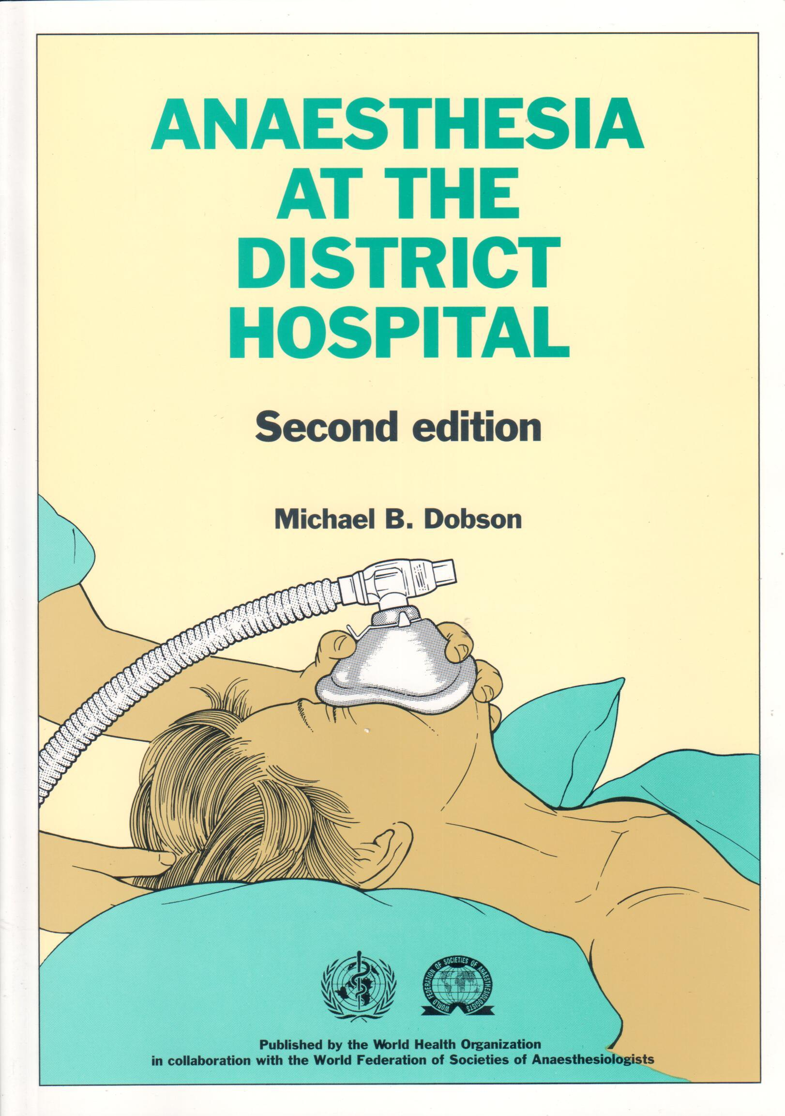
Curriculum

Slide 45
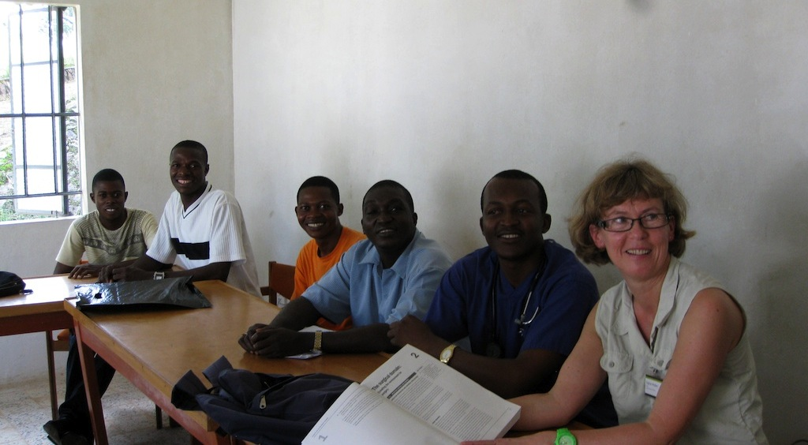
Theoretical Training

Slide 46
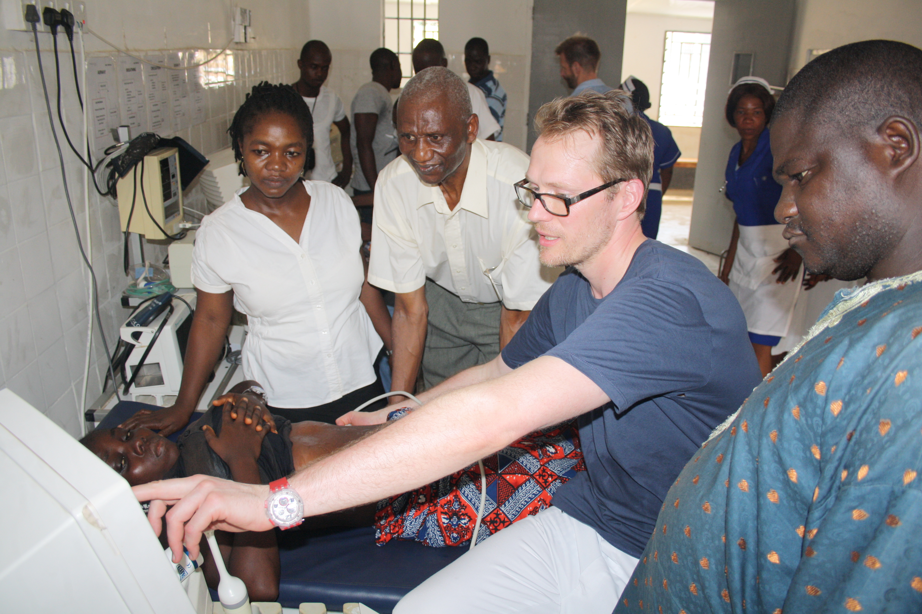
Skills Training – Ultra Sound

Slide 47
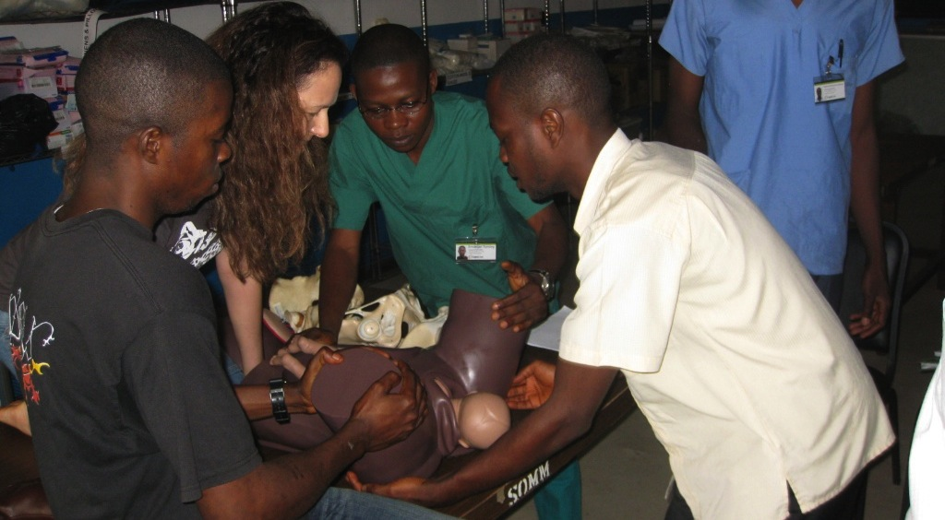
Skills Training – Obstetrics

Slide 48
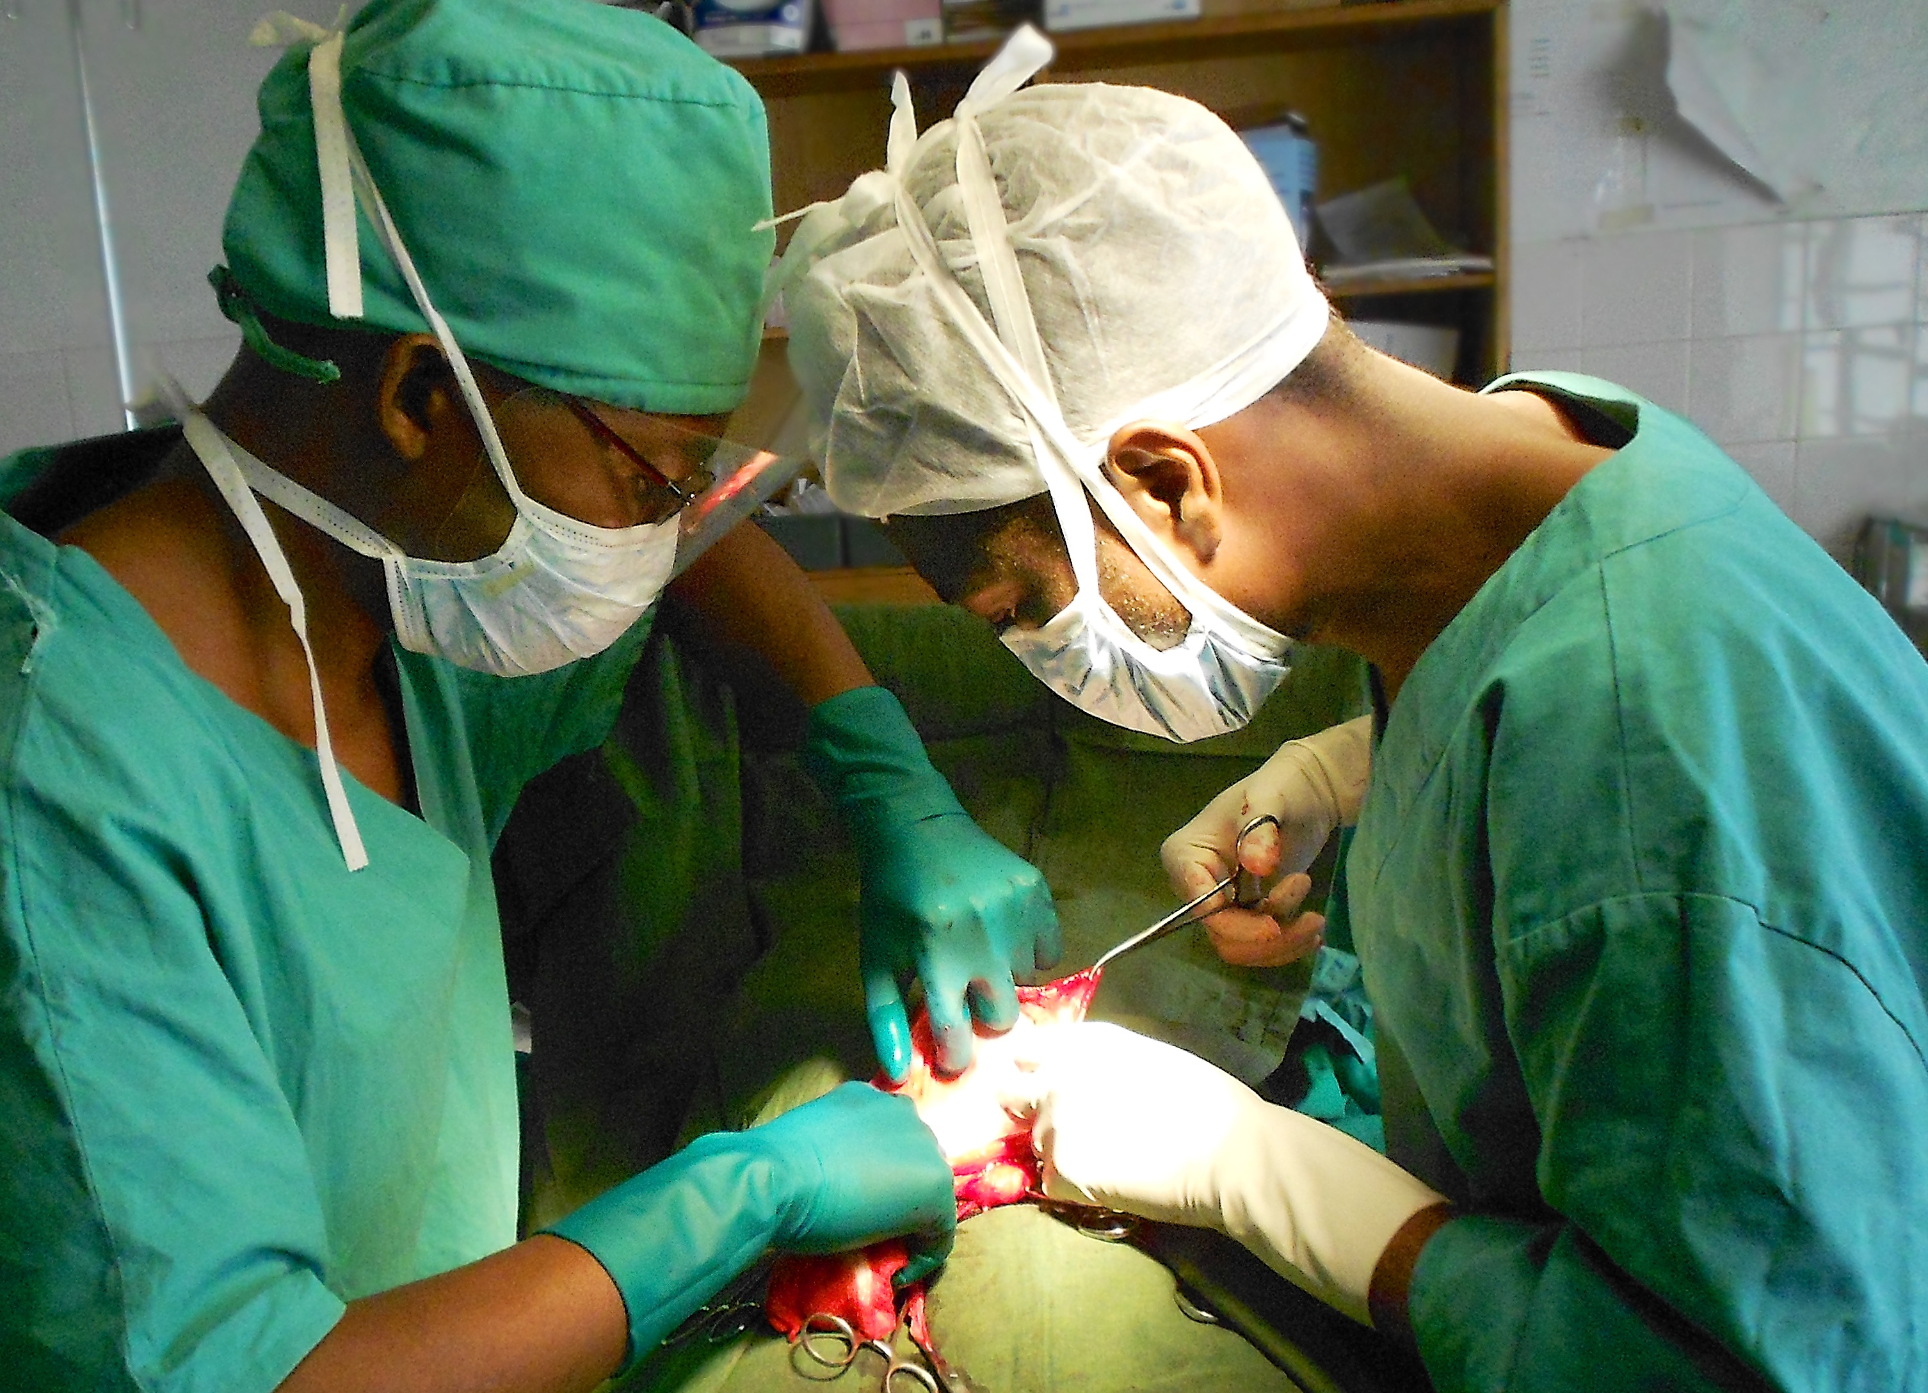
Practical training

Slide 49
Training Overview – Partner Hospitals
Hospitals are selected based upon:
Surgical capacity
Supervision
The student record all procedures in a logbook

Slide 50
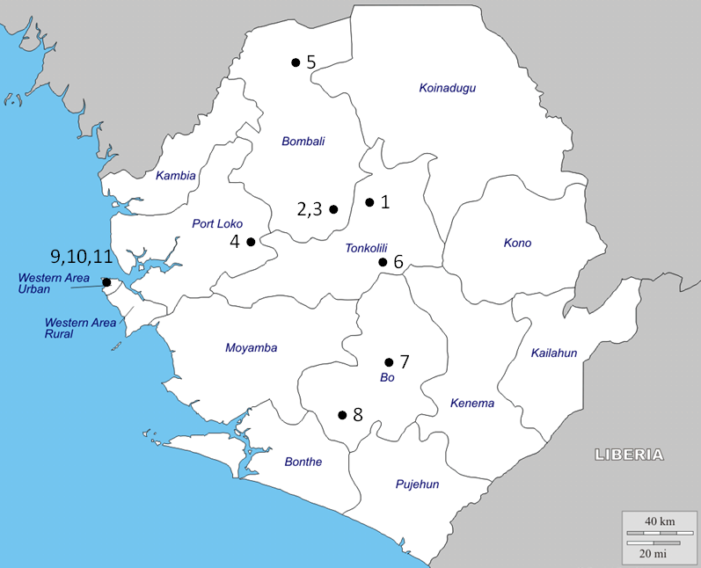
Teaching Facilities
Primary Training Center
Masanga Hospital
Partner Hospitals
Magbenteh, Makeni
Holy Spirit, Makeni
St John of God, Lunsar
Kamakwie Weslian Hospital
Lion Hearth Medical Center, Yele
Gundama Refferal Center, Bo
Serabu Catholic Hospital
Aberdeen Womens Center, Freetown
Housemanship Hospitals
Canaught University Hospital, Freetown
PCMH Maternity Hospital, Freetown

Slide 51
Training Overview – Exam
After the two years there is a examination consisting of:
Logbook
Written exam
Oral exam – conducted by the chief surgeon and the chief obstetrician

Slide 52
Training Overview – Housemanship
To asses the students in the governmental hospitals in Freetown and give them the final preparation for the work in the district hospitals
Started in March 2013

Slide 53
Number of attended procedures

Slide 54
Procedures
Role | Number | Percentage
Observer | 3306 | 18.5%
Assistant | 6916 | 38.7%
Surgeon direct supervision | 3874 | 21.7%
Surgeon indirect supervision | 3791 | 21.2%
Total | 17887 | 100%

Slide 55
Top 10 procedures
Procedure | Number | Percentage
1. Cesarean section | 4582 | 25.6%
2. Inguinal hernia | 4218 | 23.6%
3. Explorative laparotomy | 795 | 4.4%
4. Appendectomy | 650 | 3.6%
5. Dilation and curettage | 543 | 3.0%
6. Scrotal hydrocele | 519 | 2.9%
7. Tubal ligation | 514 | 2.9%
8. Incision and drainage | 499 | 2.8%
9. Hysterectomy | 490 | 2.7%
10. Obstetrics and gynecology other | 476 | 2.7%

Slide 56
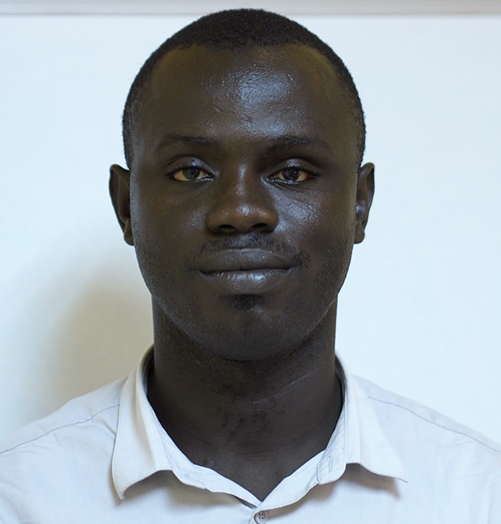
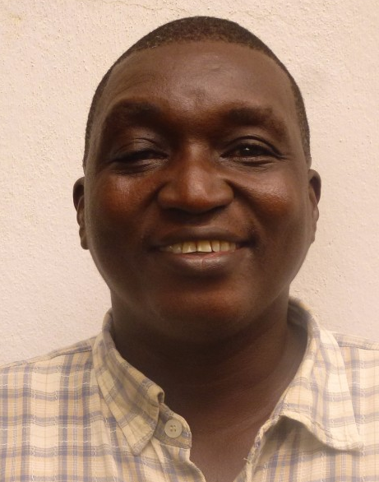
Ebola
Joseph Heindilo Ngegba
† 22nd August 2014
Samuel Batty
† 2nd December 2014

Slide 57
Discussion
Strengths:
Involvement with the Ministry of Health and Sanitation
Close contact with the students
Netwerk with partner hospitals
Challenges:
Quality controll
Legal framework
Ebola is the biggest challenge

Slide 58
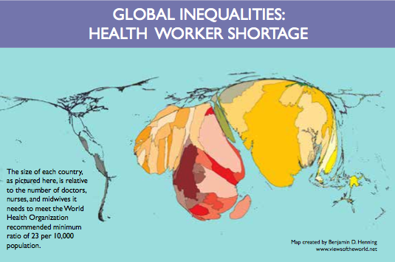
Source:
Worldmapper.org
(World Bank – data)
Notes:
Global surgery – kompetansespredning og task shifting

Slide 59
